Slide 1
FERTILIZATION
Dr. Mbira

Slide 2
Maturation of the sperm
Also called spermiogenesis and involves change from a spermatid to a spermatozoon and takes about 70 days.
The spermatids change shape from almost-spherical shape to the familiar tadpole-like shape.
Involves:
Formation of the acrosome.
Condensation of the nucleus.
Shedding of most of the cytoplasm.
Formation of neck, middle piece and tail.

Slide 3
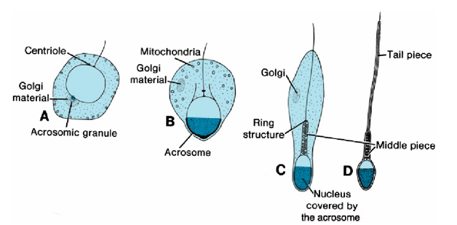

Slide 4
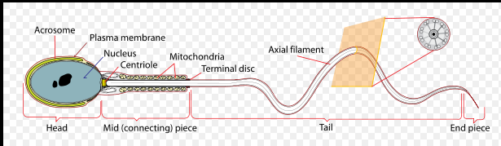
Acrosome- contains the nucleus and has enzymes which when activated and released will be important in fertilization.
Middle piece- contains mitochondria for energy
Tail piece- contains the cytoskeletal components that enable movement.

Slide 5
Maturation of the ovum
The primary oocyte will get a rim of cells derived from the surrounding stroma of the ovary to encase it to form a primordial follicle.
With each menstrual cycle, 15 or so primordial follicles will be chosen to start maturing. The rim of cells will change from being flat to cuboidal as well as multi-layered and this will become a primary follicle.
The cells surrounding the oocyte at this stage will be called granulosa cells.
A layer demarcating the oocyte from the granulosa cells will form called the zona pellucida.
Meanwhile, the surrounding stroma of the ovary around the maturing follicle will contribute cells which will surround and become cells of the follicle called theca folliculi.
The theca folliculi cells will then have 2 layers; an inner layer of cells called theca interna and an outer layer called theca externa.
Thus the maturing oocyte will be surrounded by a zona pellucida, granulosa cells and more externally the theca cells(interna and externa).

Slide 6
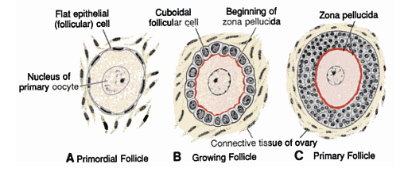

Slide 7
Granulosa cells will then develop a fluid filled cavity within them called an antrum. At this point the follicle will have matured from a primary follicle to a secondary follicle.
The granulosa cells that are next to and surround the oocyte will be called cumulus oophorus.
At this point the secondary oocyte will complete meiosis I and form 2 daughter cells. It will then freeze at metaphase of meiosis II just before ovulation and remain this way until fertilization happens.
The mature oocyte will be surrounded by fluid in the antrum and the follicle will be called a Graafian follicle.
Ovulation will lead to rupture of the fluid filled antrum and release of the mature oocyte to the region near the fimbriae of the fallopian tube.
The cavity left behind will be comprised of theca cells and will form the corpus luteum.

Slide 8
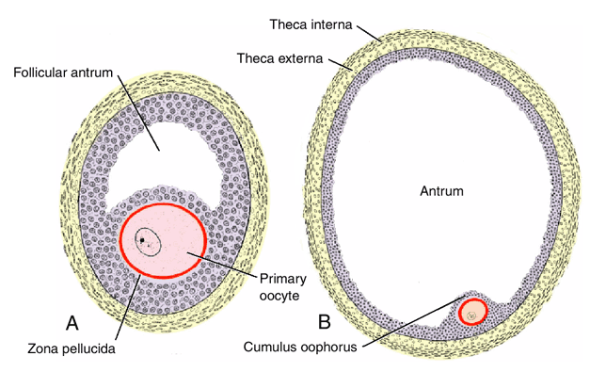
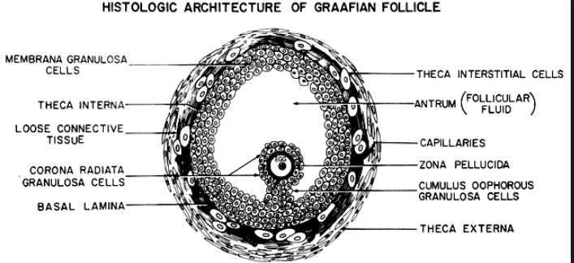

Slide 9
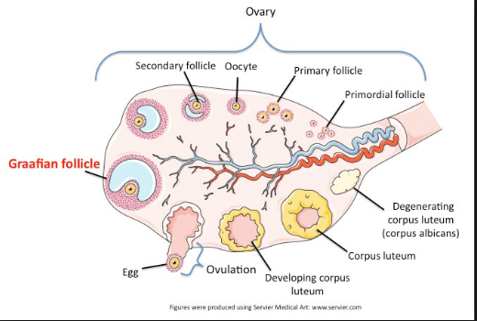

Slide 10
Granulosa cells and theca cells(esp. theca interna) under the influence of FSH produce estrogen.
Estrogen causes the following to happen:
Endometrium begins to proliferate (proliferative/follicular phase).
Cervical mucus begins to become thinner to allow passage of sperm.
Stimulates the pituitary to produce LH.

Slide 11
At midcycle there will be a surge of LH which will:
Cause maturation of the oocyte by causing “unfreezing” meiosis I, causing its completion and commencement of meiosis II.
Cause follicular cells to start producing progesterone.
Cause rupture of the follicle and release of the oocyte/ovum.

Slide 12
The ovulated oocyte will have granulosa cells that surround it which were forming the cumulus oophorus and these cells will reorganize themselves around the oocyte to form the corona radiata.
The remnant of the ruptured follicle in the ovary will have granulosa cells as well as theca cells which under the influence of LH will start producing progesterone. They will form a yellowish structure called the corpus luteum.
The progesterone secreted, together with estrogen, will:
Cause the endometrium to enter the secretional/progestational stage in preparation for implantation.

Slide 13
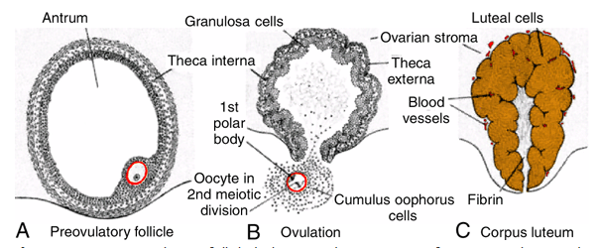

Slide 14
The oocyte is swept by the fimbriae into the lumen of the fallopian tube and also ciliae within the tube and rhythmic contractions of the tube itself help to propel the oocyte towards the uterus, a journey which takes 3-4 days.
The corpus luteum will continue to produce hormones, especially progesterone which will maintain the endometrium awaiting implantation.
If fertilization does not occur, the corpus luteum will degenerate in about 9 days and be replaced by whitish scar tissue and be termed corpus albicans.
The production of progesterone will diminish dramatically and without this hormonal support, the thickened endometrium will break down and be shed off as menstrual bleeding.
However, if fertilization occurs, the embryo produces a hormone human chorionic gonadotrophin(hCG).

Slide 15
hCG will prevent the degeneration of corpus luteum and instead will stimulate it to grow and become the corpus luteum of pregnancy which will maintain progesterone production for up to 4 months at which point the placenta will be mature enough to take over the progesterone production.
The corpus luteum of pregnancy after 4 months will then degenerate.

Slide 16
About 300 million spermatozoa are released per ejaculation.
Of these, only about 1% reach the cervix, they then take about 7 hours to reach the fallopian tube and “rest” at the isthmus. Here, they can survive for up to 3 or 4 days.
Once ovulation occurs, they become mobile again and swim towards the ampulla where they meet with the ovum/oocyte.
Fertilization usually occurs in the ampulla.

Slide 17
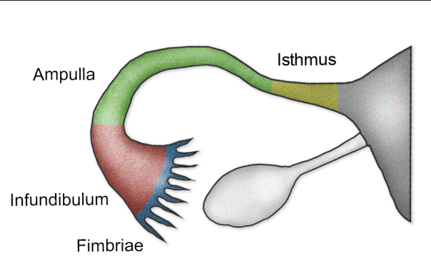
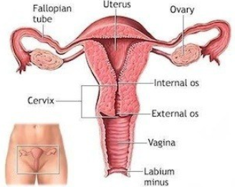

Slide 18
The sperm will undergo some changes to prime them for fertilization:
Capacitation – Plasma proteins from semen attached to the acrosomal cell membrane as well as a glycoprotein coat are shed off. Only capacitated sperm are allowed to penetrate to corona radiata.
Acrosome reaction – Once the sperm acrosome gets in contact with the zona pellucida, it releases the enzymes which will help it penetrate the zona pellucida.

Slide 19
Fertilization has 3 steps:
Penetration of corona radiata.
Penetration of zona pellucida.
Fusion of cell membranes of the sperm and oocyte.

Slide 20
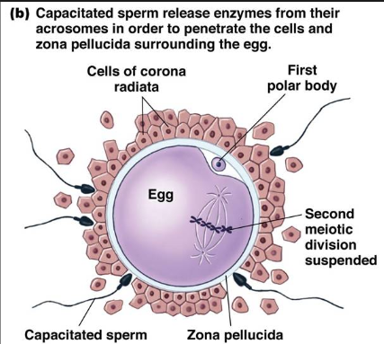
Penetration of corona radiata
Only 300-500 sperm reach the egg.
Of these, only the sperm which have been capacitated will penetrate the corona radiata.

Slide 21
Penetration of zona pellucida
Certain proteins in the zona pellucida once in contact with the sperm will induce the acrosome reaction.
The sperm head(acrosome) will release enzymes such as acrosin which will breakdown the zona pellucida and allow the sperm to get in contact with the cell membrane of the oocyte.
Contact of the sperm with the oocyte membrane causes the oocyte membrane to release substances which alter the structure of the zona pellucida making it now impermeable to any other sperm. This is known as the zona reaction.
The zona reaction ensures that only one sperm comes into contact with the oocyte cell membrane.

Slide 22
Fusion of sperm and oocyte
The cell membranes of the 2 gametes now fuse.
The oocyte also undergoes a cortical reaction making its cell membrane impenetrable to other spermatozoa.
Meiosis II is now “unfrozen” and continues to completion with the formation of the definitive oocyte having forming the female pronucleus.
The oocyte also undergoes metabolic activation allowing it to carry out the initial activities of early embryogenesis.
The sperm moves closer to the female pronucleus and also forms the male pronucleus.
During formation of the pronuclei, they replicate their haploid DNA.
They then lose their nuclear envelope, the chromatids separate and sister chromatids move to opposite poles of the cell just like normal mitosis, the cytoplasm will then divide to encompass the 2 poles to form 2 new cells with diploid chromosomes.

Slide 23
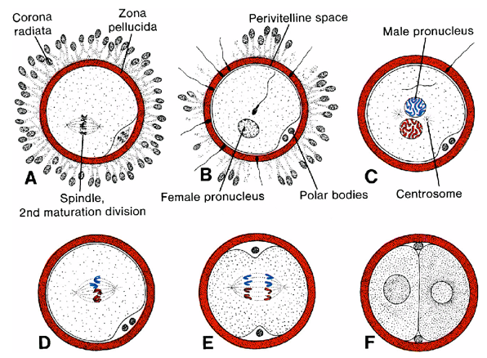

Slide 24
Fertilization restores normal cellular diploid status.
Also at fertilization the sex of the embryo to form is determined, i.e a sperm carrying X chromosome will lead to a female and that carrying Y will lead to a male since the oocyte is constantly carrying X chromosome.
Fertilization also initiates the initial cellular replication and divisions that will lead to cellular proliferation on the path to forming the new embryo. This initial process is called cleavage.
If the oocyte is not fertilize within 24 hrs, it does not undergo this cleavage and degenerates and is shed out with menses.

Slide 25
*Twin pregnancy?
*Contraception? Barrier vs hormonal

